Slide 1
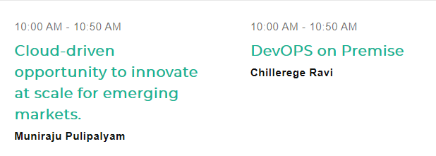
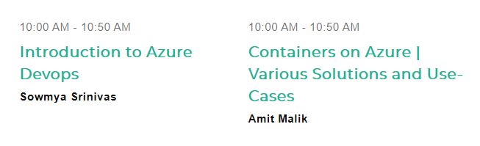

Slide 2
Azure a Polyglot Cloud
Wriju Ghosh
Cloud Solution Architect, Microsoft
@wrijugh
wriju.wordpress.com
Azure for Developers

Slide 3

#StartVM

Slide 4
Tips to developers
JavaScript, Python, Go – your language
Don’t complain about work-life balance
Watch Thoughworks Technology Rader
If you are not a passionate developer, you are not a developer
Work in group. If alone make virtual and have weekly or monthly meetup.
Greatest learning resource is your peers.
Contribute to open source projects.

Slide 5
Resources
http://github.com/wrijugh
http://dev.azure.com/

Slide 6

Future
Quantum Computing
https://www.microsoft.com/en-in/quantum/

